Slide 1
Example Map-Reduce
Dr.Preethi Ananthachari
Asst.Professor
Endicott College of International Studies
Woosong University
preethi.ga@wsu.ac.kr

Slide 2
Example
Let's check a simple example of Hadoop.
Hadoop installation delivers the following example
MapReduce jar file, which provides basic functionality of MapReduce and
can be used for calculating, like Pi value, word counts in a given list of files, etc.

Slide 3

$HADOOP_HOME/share/hadoop/mapreduce/hadoop-mapreduce-examples-3.2.2.jar
Let's have an input directory where we will push a few files and our requirement is to count the total number of words in those files.
To calculate the total number of words, we do not need to write our MapReduce, provided the .jar file contains the implementation for word count.
You can try other examples using the same .jar file;
just issue the following commands to check supported MapReduce functional programs by hadoop-mapreduce-examples-3.2.2.jar file.
Run the following command

Slide 4
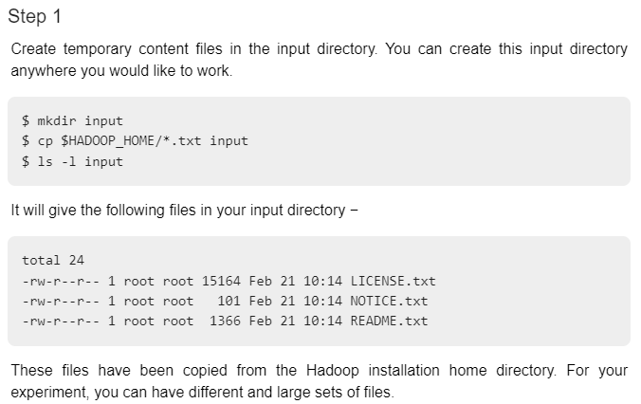

Slide 5
Suppose if the ‘cp’ command didn’t work.
Type the following in terminal
Hadoop fs –put $HADOOP_HOME/*.txt /home/hadoop/input
Let's start the Hadoop process to count the total number of words in all the files available in the input directory, as follows −

Slide 6
For creating the directory
Hadood fs –mkdir /home
Hadoop fs –mkdir /home/hadoop
Hadoop fs –mkdir /home/hadoop/input

Slide 7
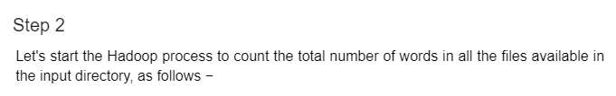
Hadoop jar $HADOOP_HOME/share/hadoop/mapreduce/hadoop-mapreduce-examples-3.2.2.jar wordcount /home/hadoop/input /home/hadoop/output

Slide 8
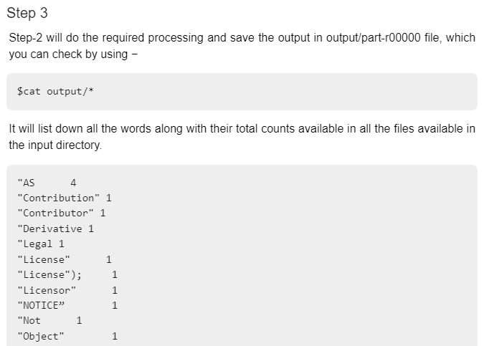

Slide 9
Display Output
If the cat command doesn’t work,
Hadoop fs –cat /home/hadoop/output/part-r-00000

Slide 10
How Map-Reduce works
A MapReduce is a data processing tool which is used to process the data parallelly in a distributed form.
It was developed in 2004, on the basis of paper titled as "MapReduce: Simplified Data Processing on Large Clusters," published by Google.
The MapReduce is a paradigm which has two phases, the mapper phase, and the reducer phase.
In the Mapper, the input is given in the form of a key-value pair.
The output of the Mapper is fed to the reducer as input.
The reducer runs only after the Mapper is over.
The reducer too takes input in key-value format, and the output of reducer is the final output.

Slide 11
Steps in Map Reduce
The map takes data in the form of pairs and returns a list of <key, value> pairs.
The keys will not be unique in this case.
Using the output of Map, sort and shuffle are applied by the Hadoop architecture.
This sort and shuffle acts on these list of <key, value> pairs and sends out unique keys and a list of values associated with this unique key <key, list(values)>.
An output of sort and shuffle sent to the reducer phase.
The reducer performs a defined function on a list of values for unique keys, and Final output <key, value> will be stored/displayed.

Slide 12
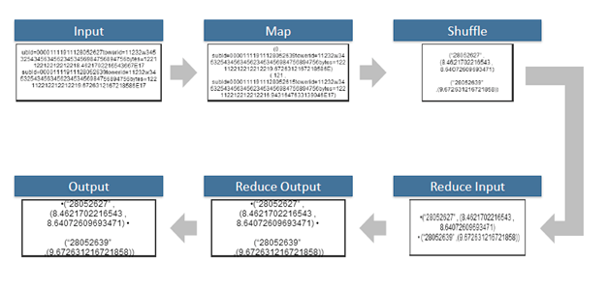
Workflow

Slide 13
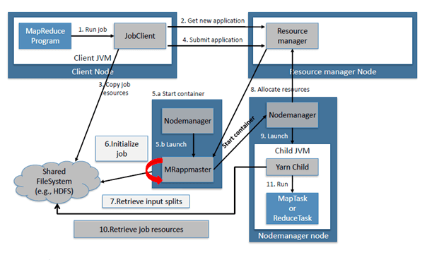
Detail

Slide 14
Sort and Shuffle
The sort and shuffle occur on the output of Mapper and before the reducer.
When the Mapper task is complete, the results are sorted by key, partitioned if there are multiple reducers, and then written to disk.
Using the input from each Mapper <k2,v2>, we collect all the values for each unique key k2.
This output from the shuffle phase in the form of <k2, list(v2)> is sent as input to reducer phase.

Slide 15
Usage of MapReduce
It can be used in various application like document clustering, distributed sorting, and web link-graph reversal.
It can be used for distributed pattern-based searching.
We can also use MapReduce in machine learning.
It was used by Google to regenerate Google's index of the World Wide Web.
It can be used in multiple computing environments such as multi-cluster, multi-core, and mobile environment.

Slide 16
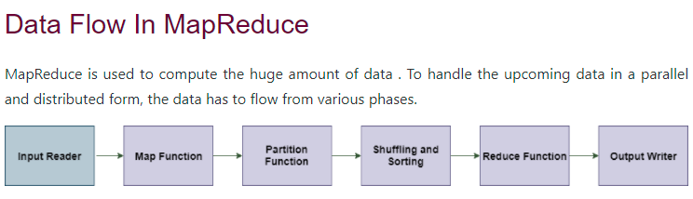
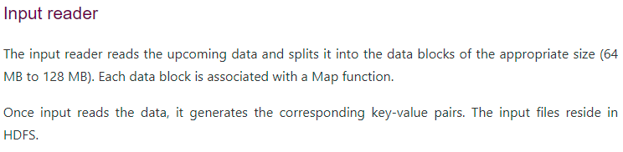

Slide 17
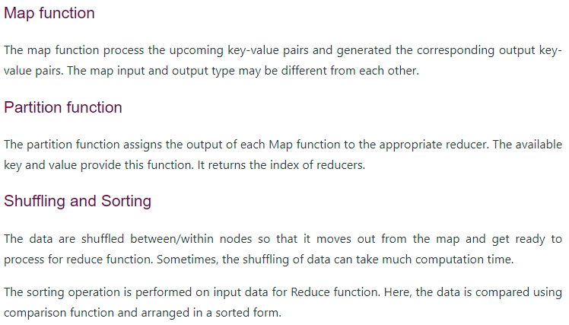

Slide 18
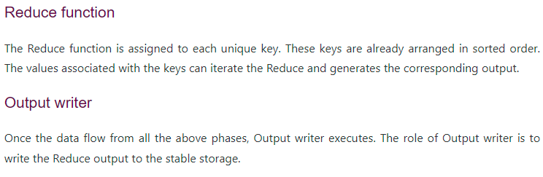

Slide 19
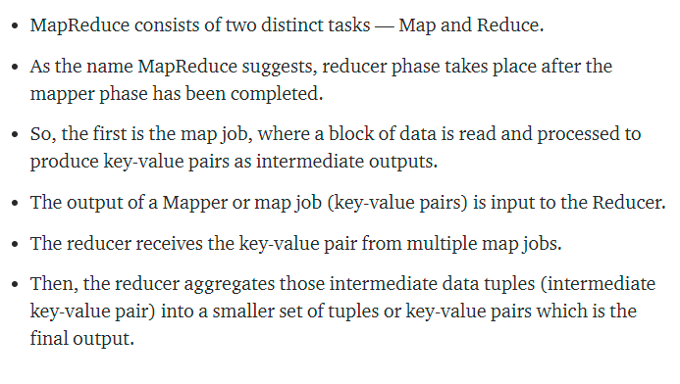
Short Explanation

Slide 20
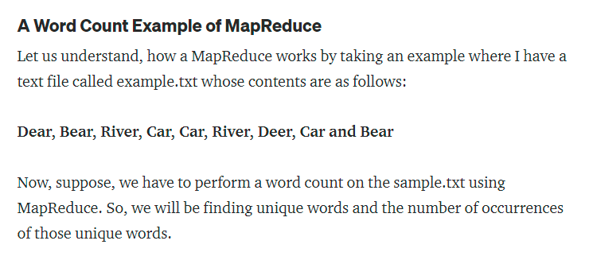

Slide 21
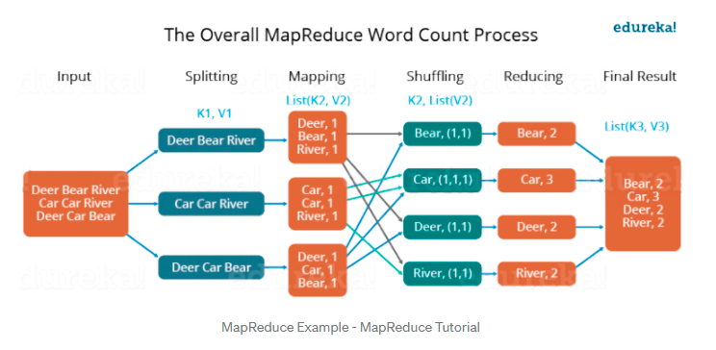
Workflow

Slide 22
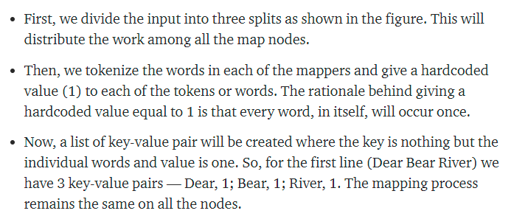

Slide 23
